Slide 1


Slide 2
XG Boost Algorithm
XGBoost (Extreme Gradient Boosting) is an advanced machine learning algorithm based on gradient boosting.
XGBoost uses decision trees as its base learners combining them sequentially to improve the model’s performance.
Each new tree is trained to correct the errors made by the previous tree
XGBoost is used for both classification and regression tasks

Slide 3
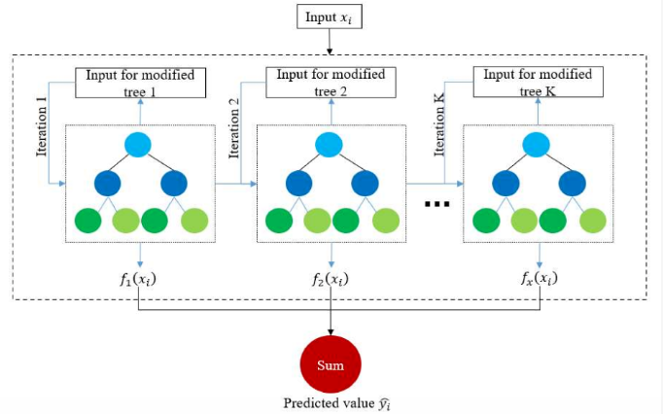
How Does XG Boost Work?
XG Boost algorithm starts with a simple decision tree and makes initial predictions.
Errors (residuals) are calculated by comparing predictions with actual values.
A new decision tree is trained to correct the previous tree’s mistakes.
This process repeats, with each tree improving upon the last.
Final model aggregates all trees to make accurate predictions.

Slide 4
XG Boost and its Unique Features
Regularization : It’s a technique used in machine learning to prevent overfitting.
Handling Missing Values : XGBoost automatically detects and processes missing values
Parallel Processing for Faster Training : reducing training time
Built-in cross-validation: Algorithm has the ability to cross-validate models while developing.

Slide 5
Advantages of XG Boost
High Performance and Accuracy
Wide Language Support (Available in Python, R, Java, Scala, Julia )
Handles large datasets efficiently

Slide 6
Disadvantages of XG Boost
Computational cost
Complex tuning
Memory usage
Harder to deploy

